Slide 1
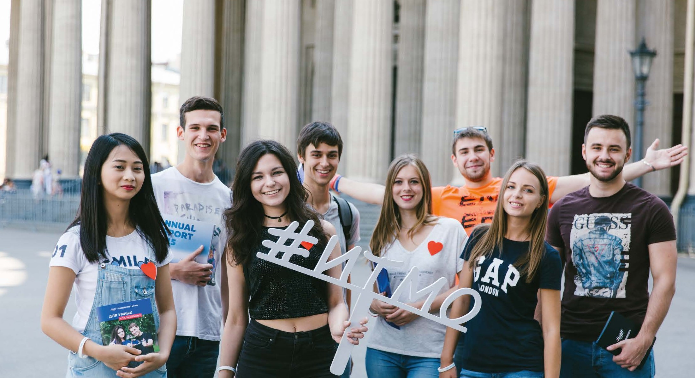

ITMO UNIVERSITY
2017
SAINT PETERSBURG
Smirnov Nikita
II class

Slide 2
INTERNATIONAL
01
02
03
RESEARCH-LED
ENTREPRENEURIAL
04
PERSON-FOCUSED

Slide 3
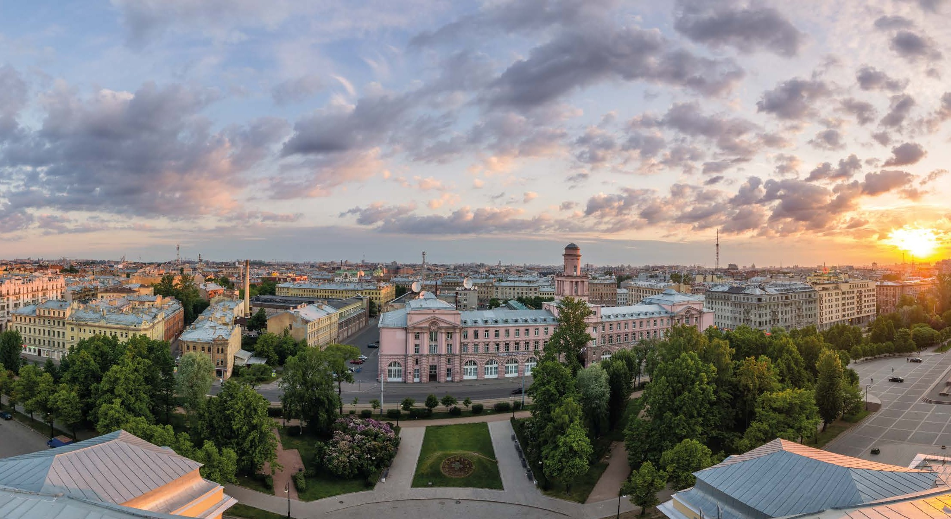
Our mission
To generate cutting-edge knowledge, implement innovative findings and prepare an elite workforce capable of working in a fast-paced world
and ensuring progress in science and technology.
Our philosophy
It's more than a University.

Slide 4


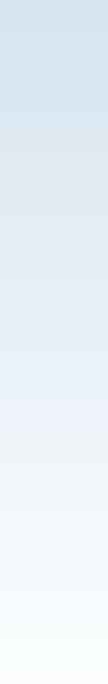
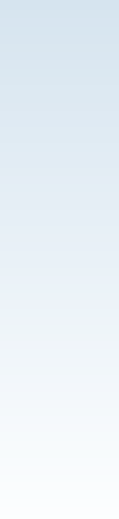

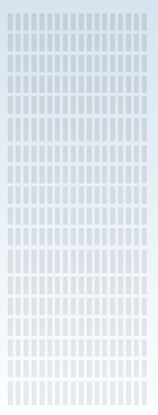
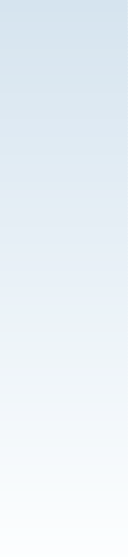

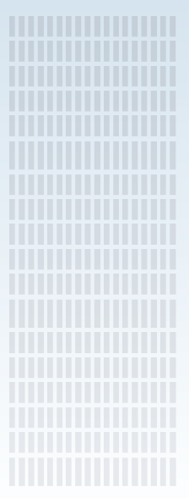



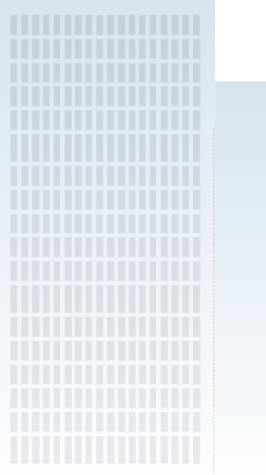
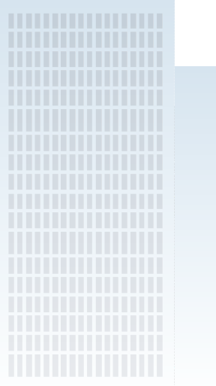
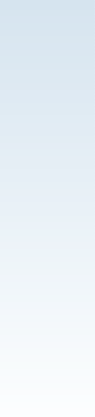
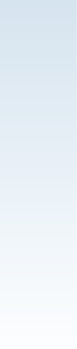

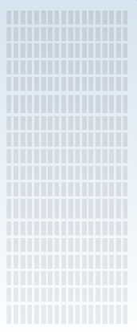
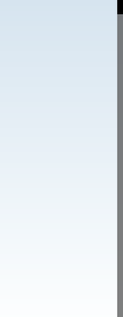


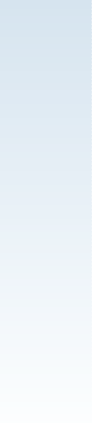

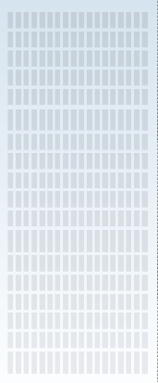
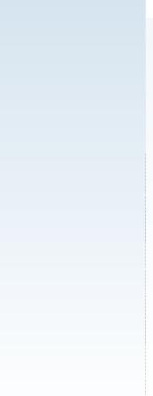







































































































































Memorable,
modern,
creative
We code, create, see the big picture and reach new heights.
Unique
New goals
Brand
All thanks to the special power of love for ITMO University.
Sense
Openness, freedom, risk
of trend
Speed
Our master key is LOVE
First non-classical university

Slide 5






The frame
is the foundation of the University, its history
ITMO University doesn't stand still
The pedals are education and science
The handlebars
are our mission
We're more than a university. Our team is crucial to us as it sets the pace, reaches the goals, makes
life at the university exciting and proves with actions that the first non-classical university is not just a slogan but a concept that helps us completely transform inside and out. Our team is always on the move.
The grips
are our values and principles
The spokes
are the key projects and focus areas
Constantly on the lookout for new ideas and projects.
Movement is life! That's why the symbol of ITMO
is a bicycle. It's environmentally friendly and it embodies mobility, dynamics, freedom and drive!
We're proud of the special creative environment
at the university that helps foster new and unique ideas.
IT
The chain
is our team
Wheels
are the University's unique research
and academic profile — IT and Photonics

Slide 6


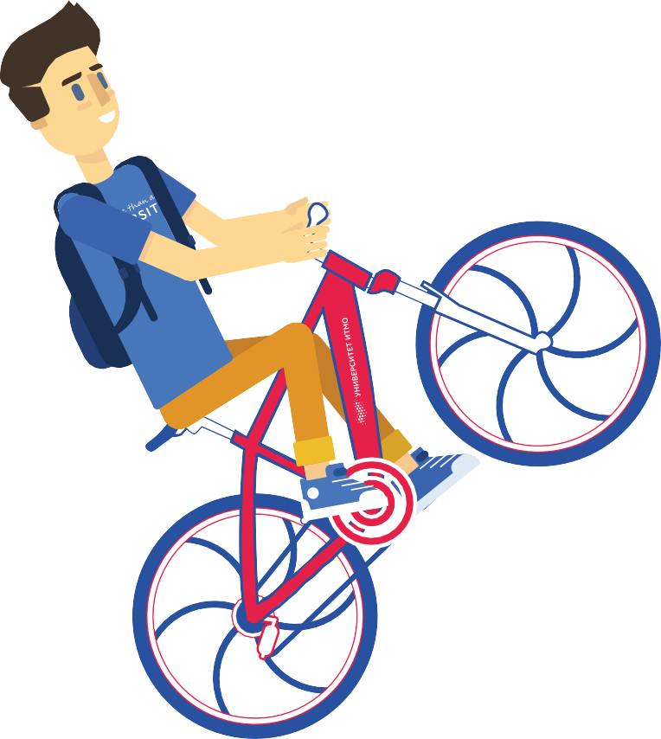











56th Place
in THE Subject Ranking for Computer Science
In THE ranking for the first time:
351-400
In overall rankings
UNESCO Medal "For Contributions
3rd place
to the Development of Nanoscience
Among Russia's universities
and Nanotechnologies"
In THE BRICS & EE
ranking and straight to the 27th place!

Slide 7
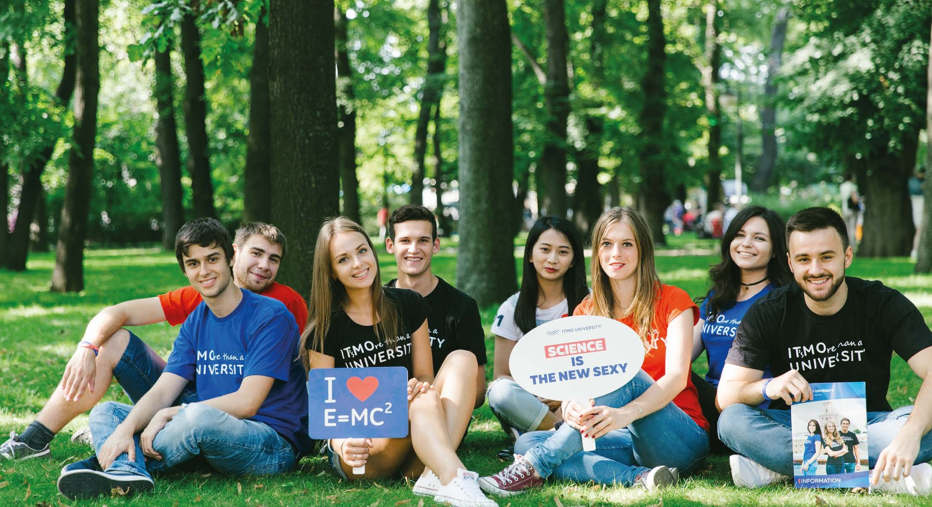
At a glance

Slide 8















At a glance
12
Math
Science
6 500
bachelor degree students
4 600 900 1 500
master PhD students foreign degree students
students from
71 countries
1 130
lecturers, professors
11 100
student body

Slide 9

2 810
Physics, Engineering and Natural Sciences
Biotechnologies
and Food Processing
1 680
Optics, Photonics and New Materials
1 500
Student body profile
Art & Urban Studies
120
Innovation Management & Business Studies
1 640
IT, Telecom, Computing and Programming
3 350

Slide 10
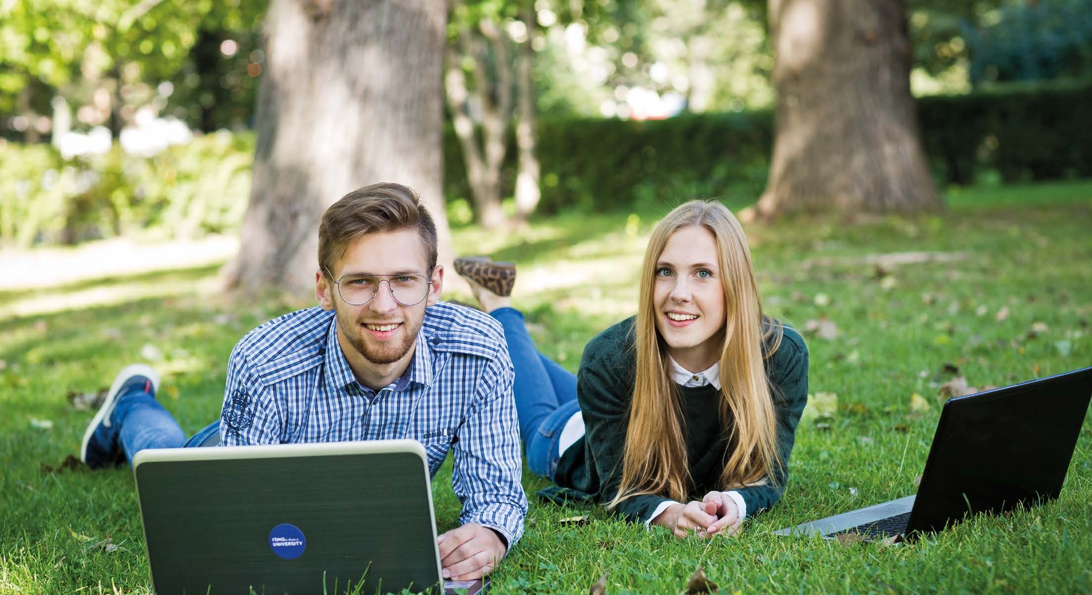
Academic Structure

Slide 11
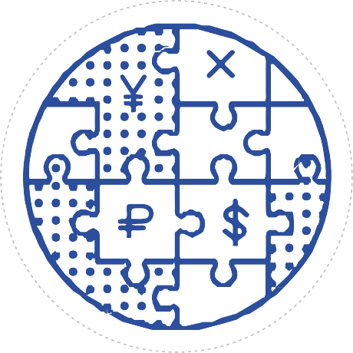

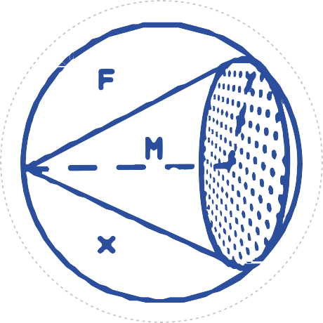


5 schools
Internet Technologies and Programming
Computer Technologies and Control
Photonics
Refrigeration Industry and Food
Biotechnologies
Economics, Management and Innovations

Slide 12





Internet Technologies
and Programming
Computer Technologies and Control
Photonics
Refrigeration Industry and Food
Biotechnologies
Economics, Management and Innovations
IT
Robotics
Laser Optics and Technologies
Innovative Foods
Management of Technological
Innovations
Smart city
Internet of Things
Refrigeration Industry
Optoinformatics
Digital Economics
“Smart House”
Biotechnologies
Economics, Management, Marketing
Light Technologies and Optoelectronics
Cyberphysical Systems
Environment Protection
Digital Navigation and Control
Sensorics
Foreign Trade
Bioengineering
Quantum Technologies

Slide 13
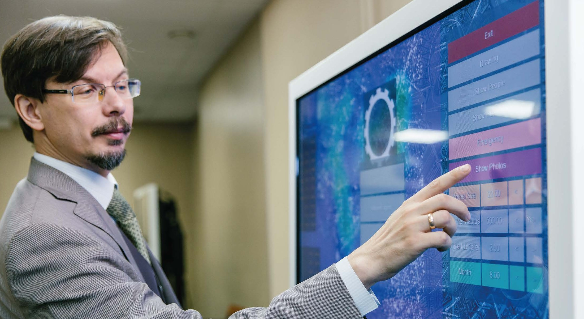
Top Research Fields

Slide 14
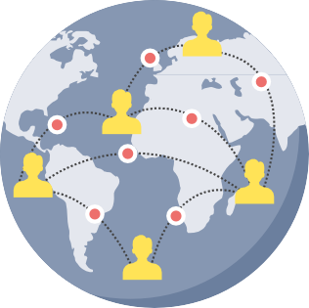








Top Research Fields
IT and Information Security
Smart Technologies and Robotics
Photonics and Quantum
Communications
Life Sciences and Translational Medicine
Natural Sciences and
"Smart Materials"
Art & Science and Lighting Design
Ecology and
Urban Science

Slide 15




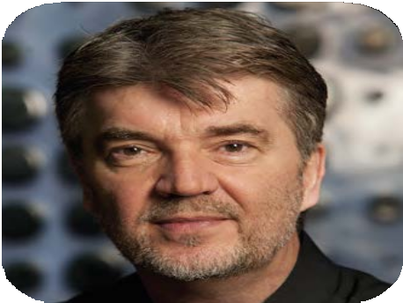
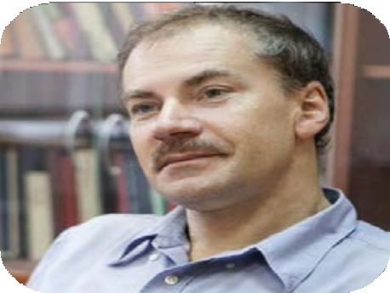
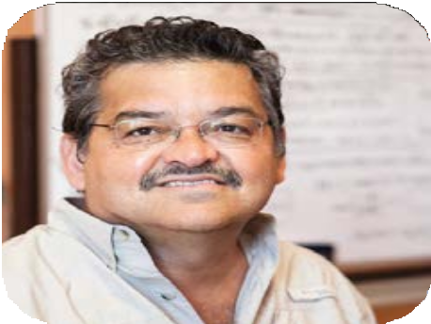
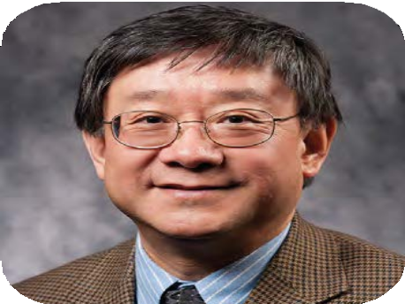
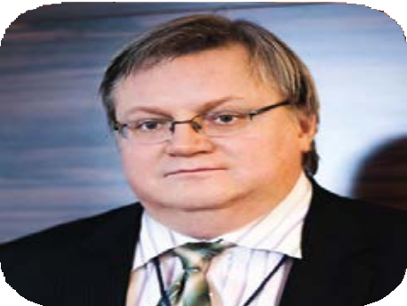
34
international research centers
+
Local and foreign scientists, graduate and postgraduate students, PhDs
+
Renowned specialists
with worldwide recognition
Leadership of ITMO International Resarch Centers
Peter M.A. Sloot
Yury Gunko
Romeo Ortega
Xi-Cheng Zhang
Yury Kivshar

Slide 16
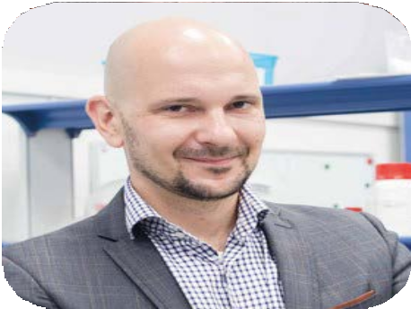
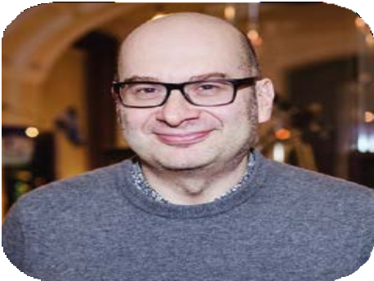
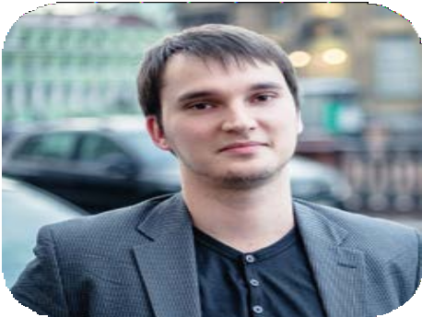
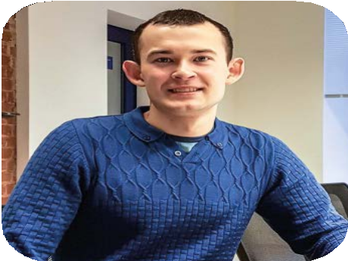
Fellowship and Professorship Program:
Internationalization of Research
100 4 3
applications applicants rounds
per year per round per year selected
17 20
professors average h-index and fellows
working
at ITMO today
Eugeny Pidko
Roberto Morandotti
Sergey Makarov
Pavel Loiko

Slide 17
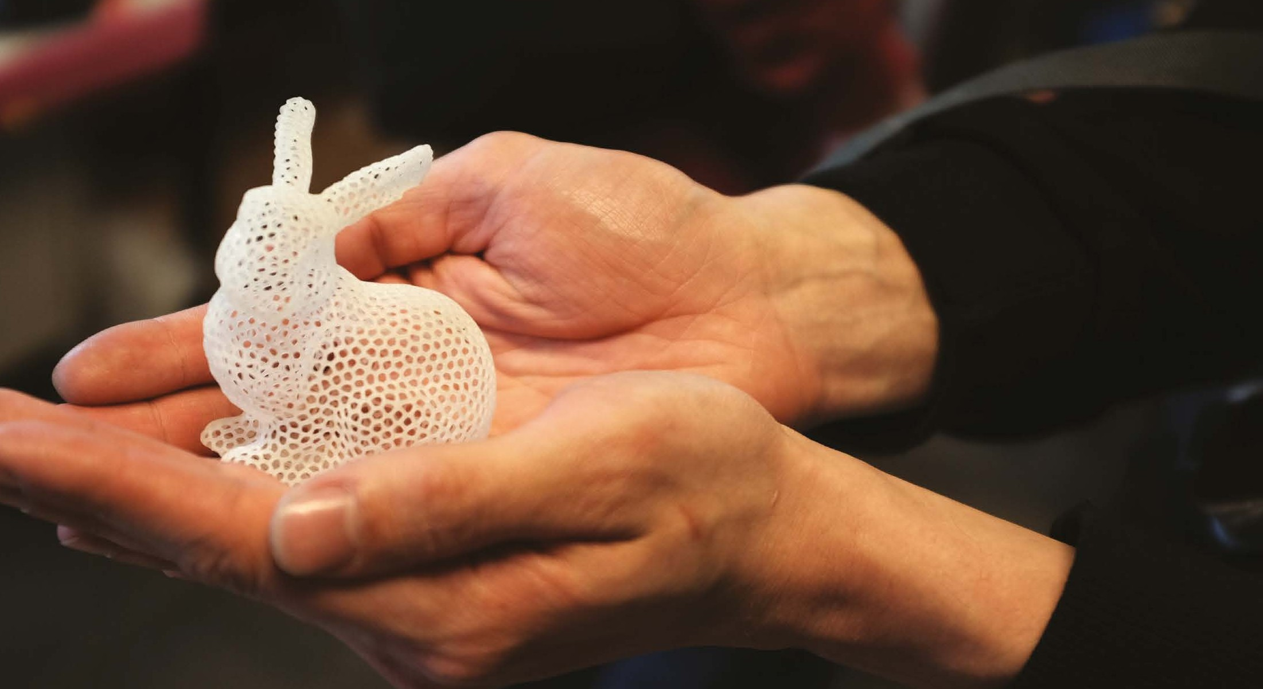
ITMO and Innovations

Slide 18
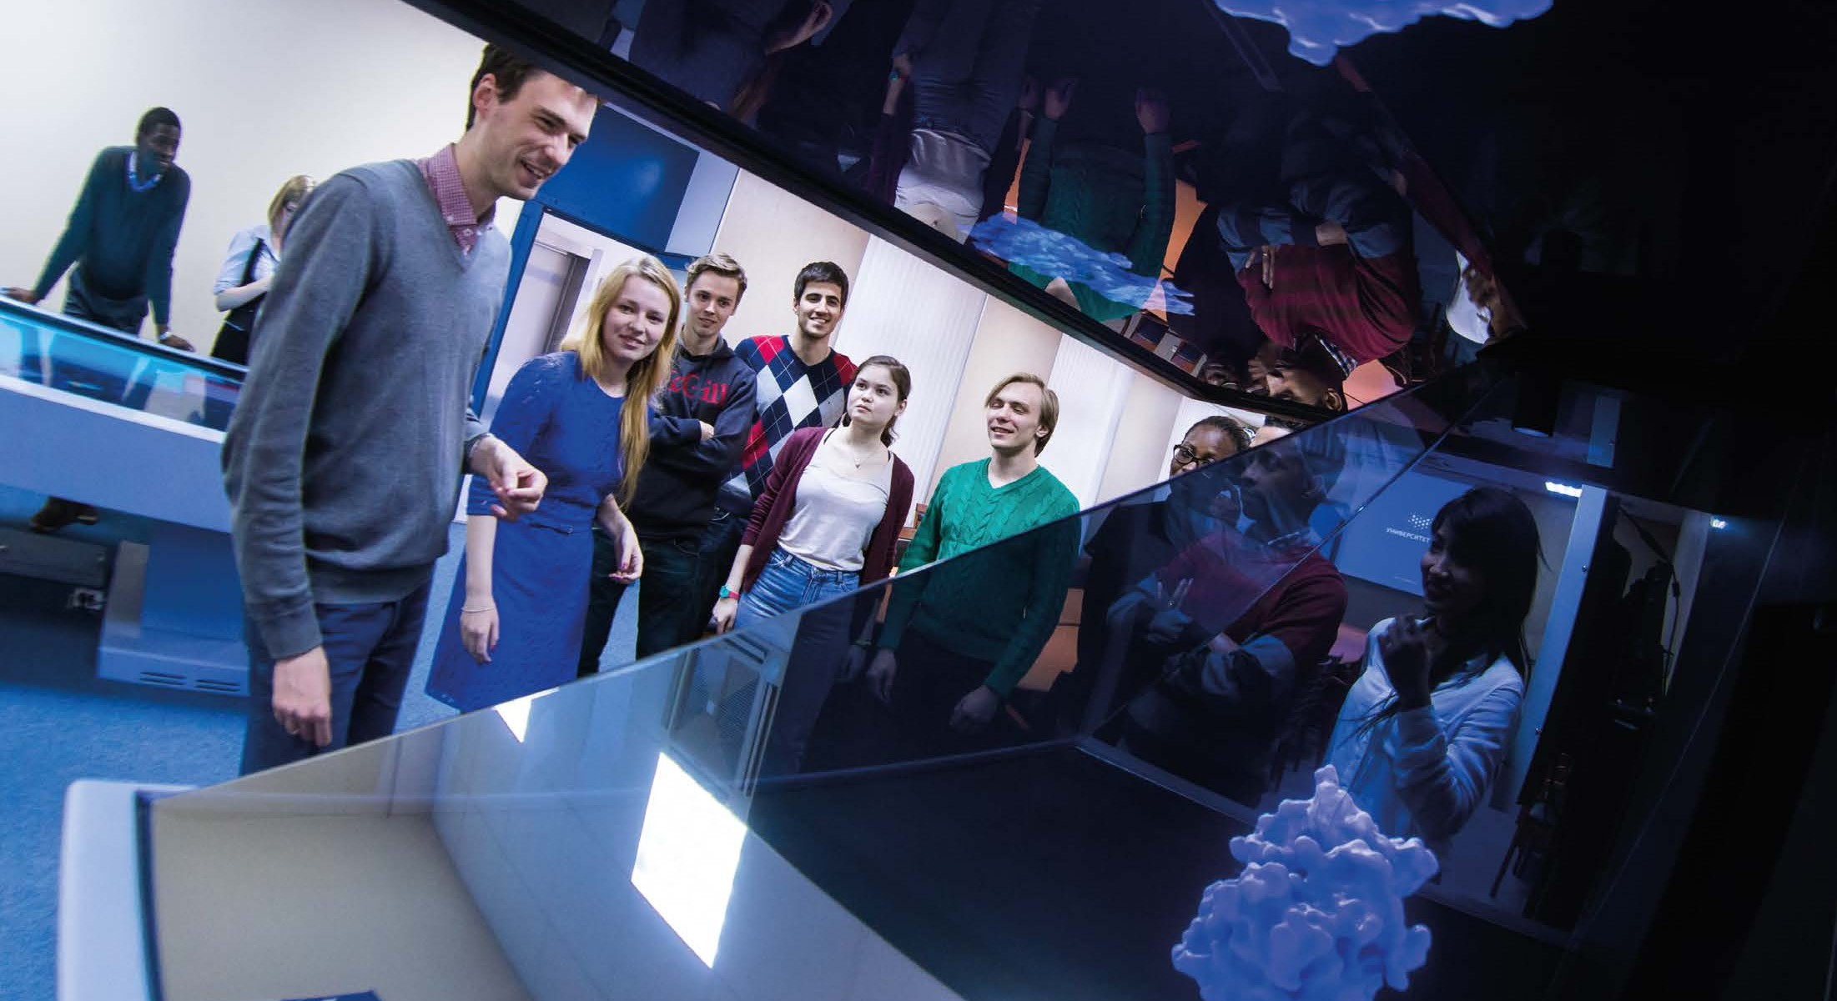
Support for Innovations
Attracting outside grants and investments
Prototyping and engineering: FabLab and OLYMP workshops, SAP Next-Gen Lab, Engineering Center
Co-working and oÆce space at the Business Incubator and Technopark
Best practices: network of startups schools, Fundraising School, Tech Brokerage School
Unique accelerator programs
Working with National Technology Initiative
Venture Fund
"ITMO Venture Partners"

Slide 19
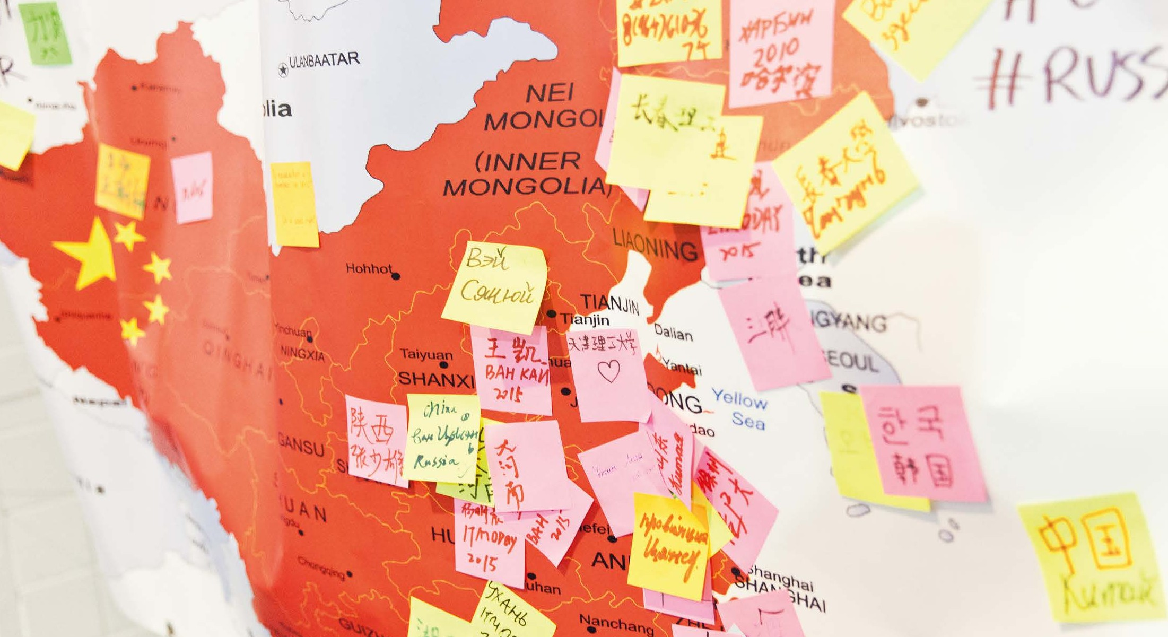
International Collaboration

Slide 20
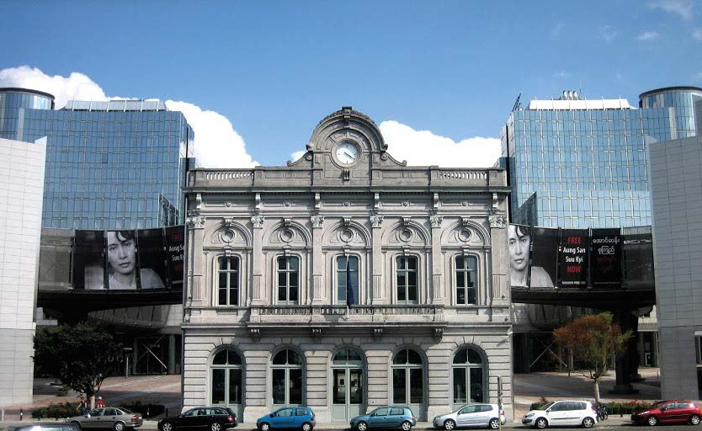
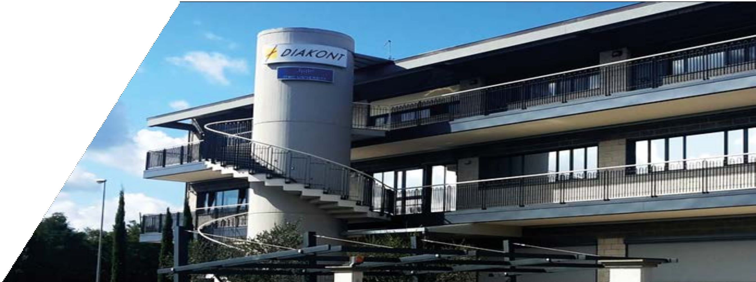
ITMO Overseas OÆces:
Global Outreach
Brussels, Belgium Arrezzo, Italy
Strengthening ties with European research and educational organizations: first ITMO representative overseas oÆce opens in 2014.
Taking breakthrough research results
to the production lines and improving student employability: ITMO and Diakont joint
oÆce in 2015.

Slide 21
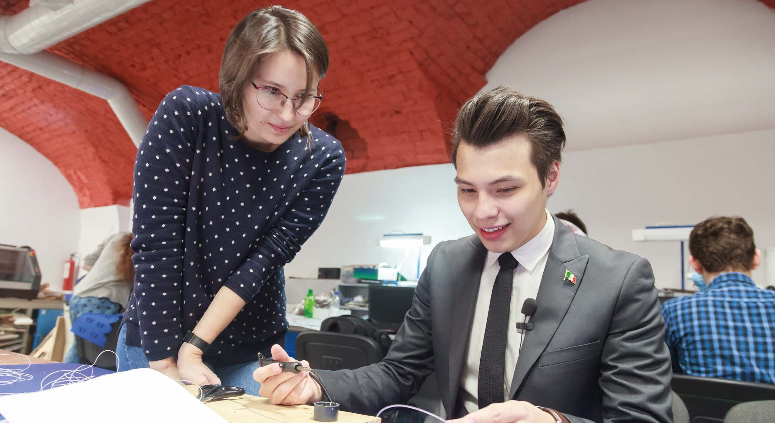
International Students
Integration and adaptation programs for foreign students
An opportunity to work and live in Russia's most European city — St. Petersburg
Immersion into university's
non-classical environment: from exciting cultural events to unique projects
Courses taught both in Russian
and English. Russian language classes available.
15% international
students in 2017
20% international
students in 2020

Slide 22
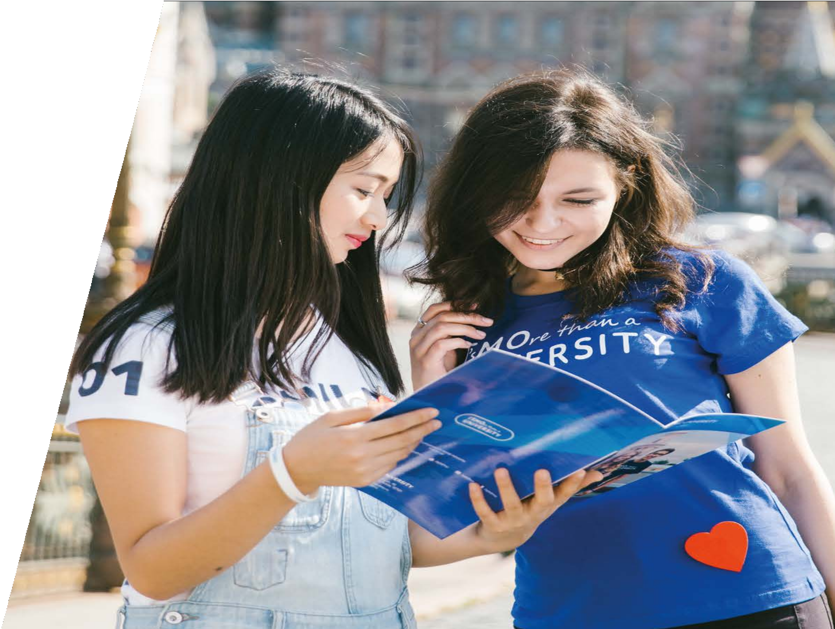
International Educational Programs
Every year ITMO U launches joint educational programs with top universities in Russia and the world.
Double Degree Programs
An opportunity to study simultaneously at ITMO and at a partner university
.
170+
Partner universities around the world
56
double degree programs today
75
programs by 2020
Learn more at en.ifmo.ru

Slide 23
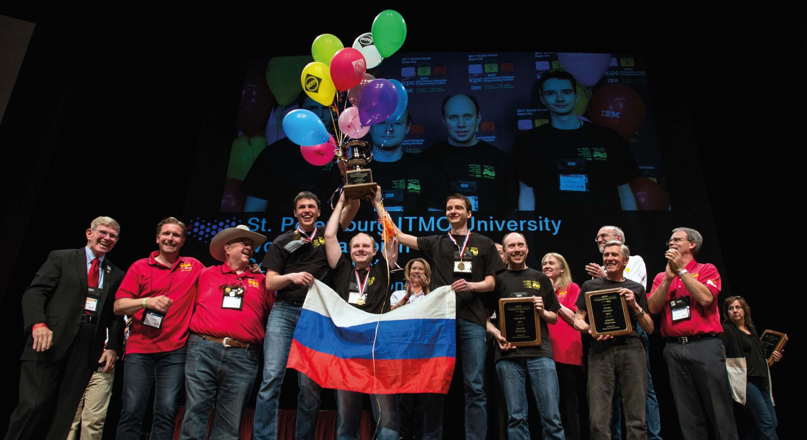
Reputation

Slide 24
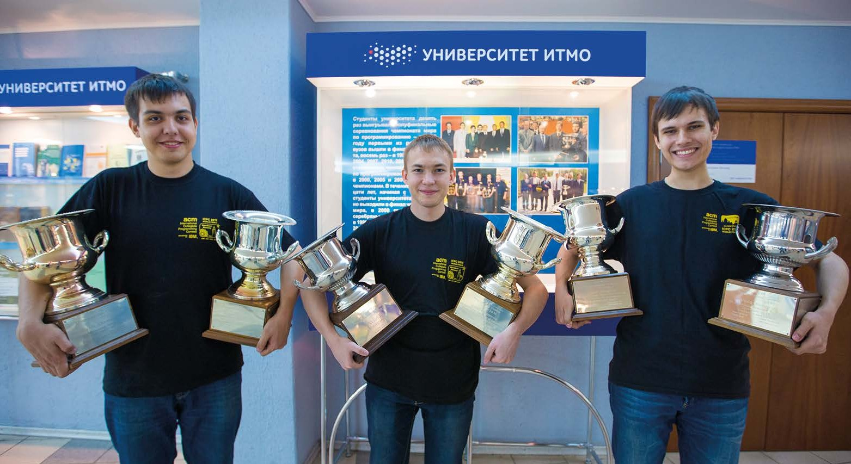
Reputation
World's only seven-time winner
of the ACM ICPC (2004, 2008, 2009,
2012, 2013, 2015, 2017)
Winner of international programming contests like Google Code Jam, Facebook Hacker Cup, Yandex.Algorithm
Named a Rising Star in Nature Index of Rising Stars (2016)
Winner of QS-APPLE Creative Award

Slide 25




Saint Petersburg, Russia
en.ifmo.ru international@mail.ifmo.ru

